Slide 1


DESIGN 1
Lesson 2: Set Up the Site: Pages, Skeletons and Navigation
Ms. Abboud • Grade 9 - Design 1 • Term 1, Week 10

Slide 2
Learning Objectives
WALT - We Are Learning To
WILF - What I'm Looking For
Create every page from my site map with a correct skeleton and the same menu.
Every page in my site map exists.
Every menu link works from every page.

Slide 3
Frayer Model: Navigation (Review)
DEFINITION
CHARACTERISTICS
The system of links (often a menu) that lets a visitor move between the different pages of a website.
Usually a list of links; appears on every page; helps users move around.
NAVIGATION
EXAMPLES
NON-EXAMPLES
A menu with Home / About / Gallery / Contact on every page.
A single link buried in a paragraph.

Slide 4
National Identity Integration
UAE Smart Government: UAE government websites are planned around the people who use them. Today you plan your own website for a specific audience, the same way.

Slide 5
STARTER
Fix It
This link does not work: <a href="About Me.html">About</a>
Why not? How would you fix it?
Hook • Engage & Ask
5 - 10 minutes

Slide 6
LESSON CORE
I Do: Files First, Then the Menu
One folder, one .html file per page, lowercase names with no spaces.
Build the menu once, then copy it into every page.
Gradual Release of Responsibility
30 - 40 minutes
Example: the same menu on every page
<nav>
<ul>
<li><a href="index.html">Home</a></li>
<li><a href="oryx.html">Oryx</a></li>
<li><a href="quiz.html">Quiz</a></li>
</ul>
</nav>
1 / 3

Slide 7
LESSON CORE
We Do: Folder Check
Show your teacher your folder and file names before you continue.
Fix any capital letters or spaces now.
Gradual Release of Responsibility
30 - 40 minutes
2 / 3

Slide 8
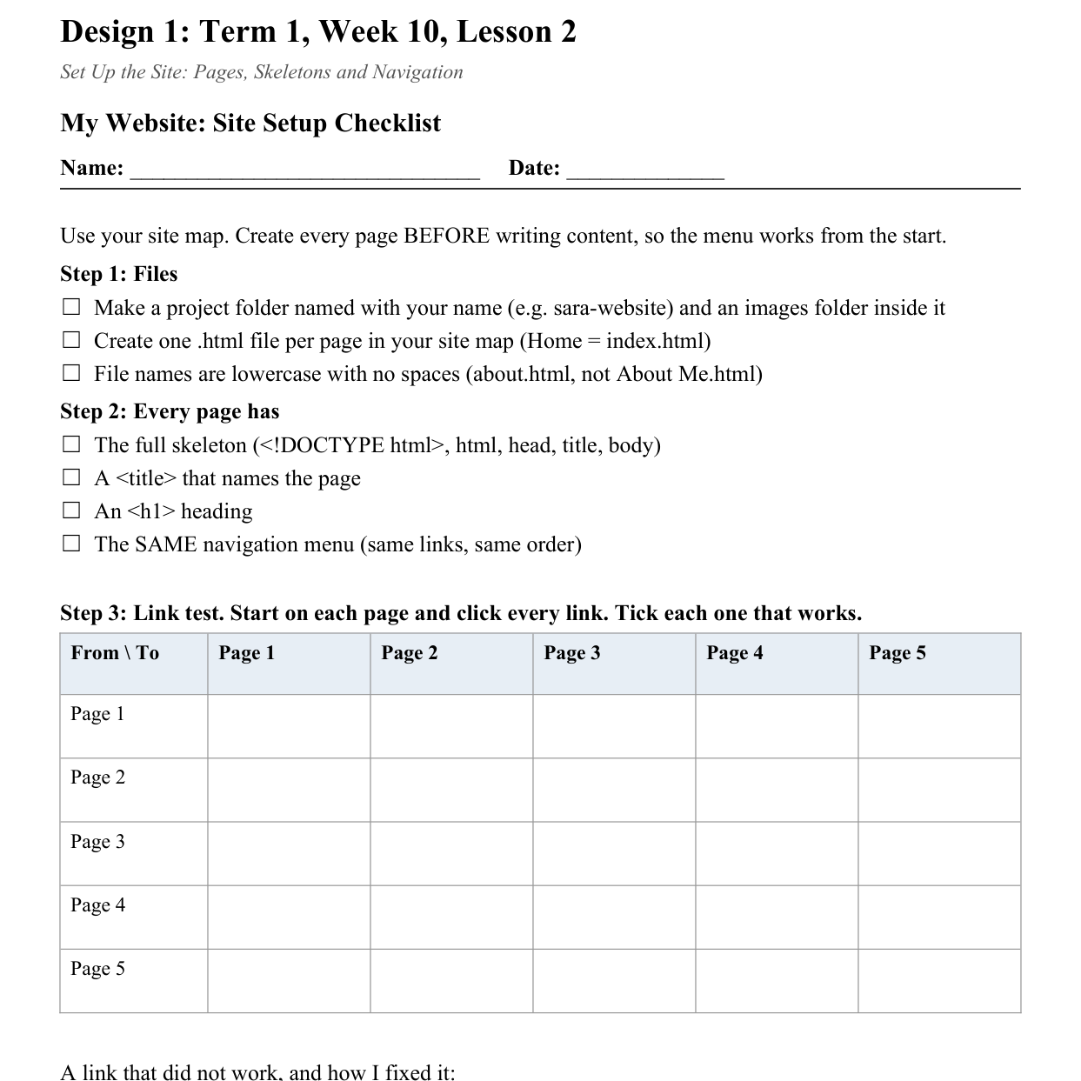
LESSON CORE
You Do: Set Up and Test
Create every page with the skeleton, a title, an h1 and the menu.
Then fill in the link test grid.
Activity: Site Setup Checklist
Gradual Release of Responsibility
30 - 40 minutes
3 / 3

Slide 9
CLOSURE
Link Test
Start on any page and reach every other page while your teacher watches.
Transition & Extend
5 - 10 minutes

